Slide 1
Global warming.
Independent research.

Slide 2
INTRODUCTION.
There is a worldwide need for freshwater. This has been brought about by the scarcity of freshwater resources in many parts of the world. This stands as a complex problem. Arguably, this can be attributed to climate change hence it calls for the need of making seawater drinkable. Now the questions is, can we make seawater drinkable water? This question is answered in this presentation. The video on how can we survive without Antarctica and sea level rise reveals a couple of things. It might be hard to survive without Antarctica because it provides water in New York and other parts of the continent,. We depend on the water that comes from meting of ice sheet of antarctica.
Notes:
There is a worldwide need for freshwater. This has been brought about by the scarcity of freshwater resources in many parts of the world. This stands as a complex problem. Arguably, this can be attributed to climate change hence it calls for the need of making seawater drinkable. Now the questions is, can we make seawater drinkable water? This question is answered in this presentation. The video on how can we survive without Antarctica and sea level rise reveals a couple of things. It might be hard to survive without Antarctica because it provides water in New York and other parts of the continent,. We depend on the water that comes from meting of ice sheet of antarctica.
The video addresses global warming that has increased in the environment resulting from human activities and industrialization. It refers to the process where there is a release of excess heating of earth for a long time, leading to high greenhouse gas levels in the atmosphere. Global warming leads to climate change, which may threaten human beings' survival and other life. Human beings escalate climate change.

Slide 3
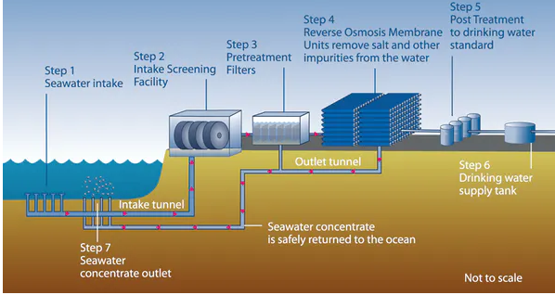
is possible to make sea water into drinkable water?
There is a large of people in need of water.
The questions have been if it is possible to make seawater drinkable.
With plants desalination could e the best way to fix this problem.
Desalination plants are the easiest and possible solution to make ocean or sea water drinkable.
This water is undrinkable and mostly saturated with salts
The image alongside shows desalination process
Notes:
There is a large of people in need of water. The questions have been if it is possible to make seawater drinkable. The proposition of this video is that with plants desalination could e the best way to fix this problem. Desalination plants are the easiest and possible solution to make ocean or sea water drinkable. I would like to agree with the fact 1/3 people find it difficult to get access to drinking water. Some time the water might be available but not safe for drinking because over 96% of the water that we depend on is found in seas and oceans. This water is undrinkable and mostly saturated with salts

Slide 4
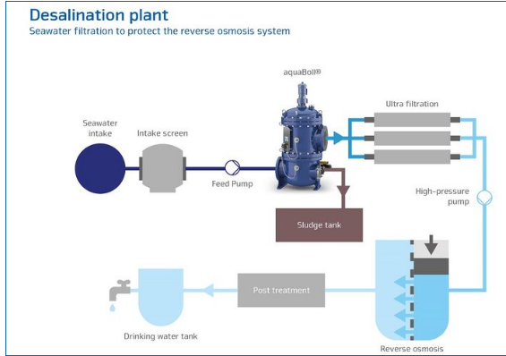
How To Fight water scarcity through Desalination
To fight against scarcity of water desalination is vital method.
In reality, the reliability of desalination has become critical.
The desalination Process requires sea water and energy.
The energy for desalination is costly
It also has adverse environmental effects
In seawater filtration is used in desalination process
This important in prevention of reverse osmosis systems Impurities are removed from sea water through self-cleaning filtration
Notes:
To fight against scarcity of water desalination is vital method. In reality, the reliability of desalination has become critical. To make the sea water drinkable you only need to have desalination plant, sea water and energy. However, there are concerns that much energy might be required in this process and it also has adverse environmental effects. In seawater filtration is used in desalination process.
This important in prevention of reverse osmosis systems Impurities are removed from sea water through self-cleaning filtration.

Slide 5
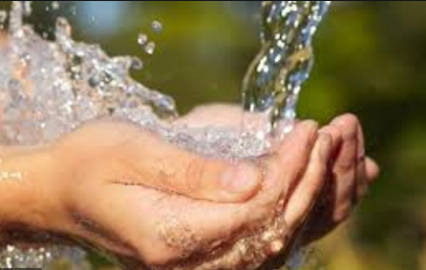
Benefits of desalination.
It avails clean drinking water.
It provides water that can be used in the agriculture industry.
Desalination enables the preservation of freshwater supplies.
Promotes the quality of water for human consumption.
Notes:
It avails clean drinking water.
It provides water that can be used in the agriculture industry.
Desalination enables the preservation of freshwater supplies.
Promotes the quality of water for human consumption.

Slide 6
Barriers To Desalination
The scarcity of water is a complex issue and really a difficult problem to handle.
There is still growing uncertainty about water shortage being introduced by climate change.
Now since we need to have clean and fresh water to use at homes, desalination is one of the ways in which we can make this water safe to drink.
This process requires a lot of energy
It is a challenge to advocate for great technology to solve this issue.
Notes:
Barriers to desalination
The scarcity of water is a complex issue and really a difficult problem to handle. There is still growing uncertainty about water shortage being introduced by climate change. Now since we need to have clean ad fresh water to use at homes, desalination is one of the ways in which we can make this water safe to drink. However, it’s a process that requires a lot of energy and it is a challenge to advocate for great technology to solve this issue.

Slide 7
Melting of Antarctica and its effects.
Melting results in to increase in sea levels.
Melting may destroy cities through flooding.
Destruction of the human population.
Destruction of the aquatic life.
Notes:
The weather patterns are changing, characterized by increased global temperatures. The high temperatures contribute to the melting of the frozen water in Antarctica, which raises the sea levels rapidly. The impact of the melting is fatal, especially to the safety of the human population. High sea levels have a destructive effect on the aquatic life and human population. Melting results in global warming, which has raised the temperatures in the atmosphere.

Slide 8
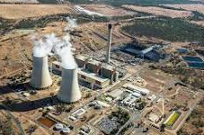
Causes of global warming.
Environment unfriendly activities and the concentration of greenhouse gases.
Emission of toxic gases into the atmosphere and Climate change.
The causes of global warming surround human activities that cause overheating of the earth atmosphere. The main cause of global warming is the concentration of greenhouses gases that result in high temperatures in the earth.
The emission of toxic gases such as carbon monoxide which exposes to industries. Climate change has led to global warming, where there is the destruction of the ozone layer
Notes:
The causes of global warming surround human activities that cause overheating of the earth atmosphere. The main cause of global warming is the concentration of greenhouses gases that result in high temperatures in the earth. The emission of toxic gases such as carbon monoxide which exposes to industries. Climate change has led to global warming, where there is the destruction of the ozone layer

Slide 9
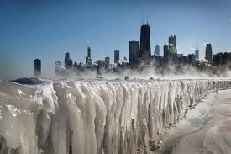
Impact of high sea levels.
It may lead to destructive erosion and destruction of aquatic life and other animals.
It may lead to contamination of soil used for agriculture and result in flooding of the wetland.
Seas hold a high amount of frozen water that would be melted with global warming.
The impact of such an increase in sea level would be felt across all continents on earth.
The high sea level threatens aquatic life and sustainability of the ecosystem.
It would lead to destructive erosion in farms, causing the displacement of properties and human beings.
It may also result in contamination of soil The, which is relied upon for agriculture. This may also result in flooding in the wetland and dryland.
Notes:
Seas hold a high amount of frozen water that would be melted with global warming. The impact of such an increase in sea level would be felt across all continents on earth. The high sea level threatens aquatic life and sustainability of the ecosystem. It would lead to destructive erosion in farms, causing the displacement of properties and human beings. It may also result in contamination of soil The, which is relied upon for agriculture. This may also result in flooding in the wetland and dryland.

Slide 10
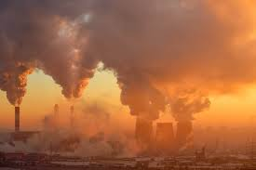
Methods of desalination.
It is the process of making seawater drinkable.
Refers to the removal of dissolved minerals from seawater or treated wastewater.
Distillation.
Vacuum freezing.
Reverse osmosis.
Electrodialysis.
Notes:
The seawater, which is usually salty, can be made drinkable through modern technology and some applicable traditional methods. Desalination refers to the process of removing the dissolved minerals in the seawater or treated wastewater. Various methods can be used to perform desalination. Owing to technology, one of the ways that are commonly used is electrodialysis. Other methods include distillation, vacuum freezing, and reverse osmosis.

Slide 11
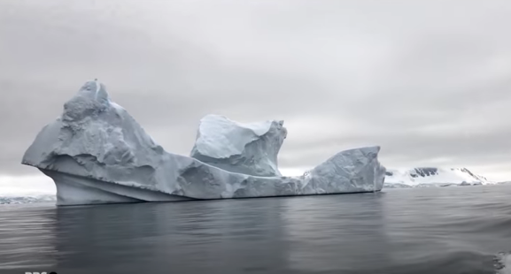
Can We Survive Without Antarctica And Sea Levels Rise?
Antarctica is covered by thick sheet of ice which we depend as the main source of water supply
This ice is increasingly being flattened
This is so because of climate change
The average mass loss of ice stands at 125 Gigatons per year
New York city uses the water from Antarctica every day
Notes:
Antarctica is covered by thick sheet of ice .This ice is increasingly being flattened .This is so because of climate change. The average mass loss of ice stands at 125 Gigatons per year . New York city uses the water from Antarctica every day

Slide 12
Can We Survive Without Antarctica And Sea Levels Rise?
Human life negatively impacted if all the ice in Antarctica melted, and the sea levels rose. Large quantities of the planet's water exist in solid form.
One part of the earth where water mainly exists in solid (ice) form in Antarctic. If all the ice in this part of the earth were to melt, the water would end up in the seas, raising the seawater level.
Melting of all the ice in Antarctica would result in a 68.3 meters rise in the sea level. (RealLifeLore, 2:00-2:10). The rise of seawater levels would lead to submersion of human habitats in different parts of the earth.
Islands such as Maldives, Kiribati, Tuvalu, and Marshal would completely be buried underwater (RealLifeLore, 1:18). They would be driven out of existence. Submersion of such large land masses that serve s homes for large populations of people means destroying human life.
Notes:
Human life negatively impacted if all the ice in Antarctica melted, and the sea levels rose. Large quantities of the planet's water exist in solid form.
One part of the earth where water mainly exists in solid (ice) form in Antarctic. If all the ice in this part of the earth were to melt, the water would end up in the seas, raising the seawater level.
Melting of all the ice in Antarctica would result in a 68.3 meters rise in the sea level. (RealLifeLore, 2:00-2:10). The rise of seawater levels would lead to submersion of human habitats in different parts of the earth.
Islands such as Maldives, Kiribati, Tuvalu, and Marshal would completely be buried underwater (RealLifeLore, 1:18). They would be driven out of existence. Submersion of such large land masses that serve s homes for large populations of people means destroying human life.

Slide 13
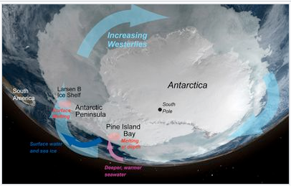
Continued: Can We Survive Without Antarctica And Sea Levels Rise?
Antarctica has profound impacts on climate of the earth as well as oceanic system
It is very important as it supports human activities
It maintains Heat balance on the Earth
The ice formed in Antarctica brings about new climate Patterns due to climate change.
It could be difficult to survive without Antarctica
Remote Antarctic is important in warming the world
Notes:
Antarctica has profound impacts on climate of the earth as well as oceanic system. It is very important as it supports human activities .It maintains Heat balance on the Earth. The ice formed in Antarctica brings about new climate Patterns due to climate change. It could be difficult to survive without Antarctica. Remote Antarctic is important in warming the world

Slide 14
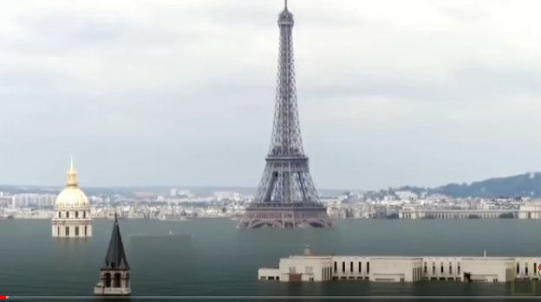
Human Survival And Sea Level Rise
The rise in sea level affects human life in different ways
The sea level rises due to melting of ice sheet
People are affected based on where they live
The salty water might get In areas where people do farming, the flood of seawaters will contaminate soils with salt from sea
into groundwater and make fresh water salty
This will affect the sources of drinking water
The rise of seal level near coastal cities result into flooding which submerges human settlements
Notes:
The rise in sea level affects human life in different ways .The sea level rises due to melting of ice sheet. People are affected based on where they live. In areas where people do farming, the flood of seawaters will contaminate soils with salt from sea. The salty water might get into groundwater and make fresh water salty. This will affect the sources of drinking water . The rise of seal level near coastal cities result into flooding which submerges human settlements

Slide 15
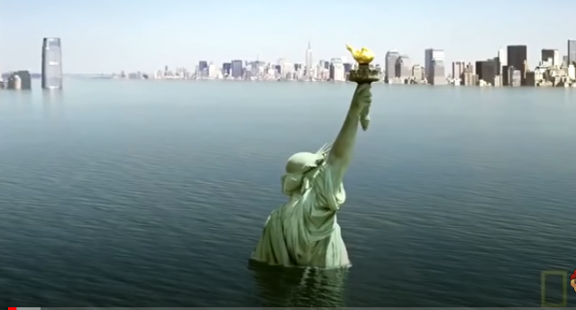
Continued: Can the Human Population Survive Without Antarctica And Sea Level Rise?
The rise of seawater levels would lead to submersion of human habitats in different parts of the earth.
Islands such as Maldives, Kiribati, Tuvalu, and Marshal would completely be buried underwater (RealLifeLore, 1:18).
They would be driven out of existence. Submersion of such large land masses that serve s homes for large populations of people means destroying human life.
Notes:
The rise of seawater levels would lead to submersion of human habitats in different parts of the earth.
Islands such as Maldives, Kiribati, Tuvalu, and Marshal would completely be buried underwater (RealLifeLore, 1:18).
They would be driven out of existence. Submersion of such large land masses that serve s homes for large populations of people means destroying human life.

Slide 16
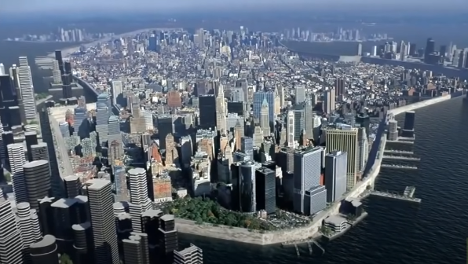
Continued: Can The Human Population Survive Without Antarctica And Sea Level Rise?
Besides islands, multiple other dry landmasses would be destroyed. For instance, most coastal cities in the northern part of the American continent would be covered by water.
Some of the highly populated North America cities that would be destroyed would go under include Vancouver, Seattle, Portland, San Diego, and Los Angeles (RealLifeLore, 2:12-2:38).
All these coastal cities and their human population would be no more as they would be swallowed by the sea.
Some cities such as Palm Springs that are far from the sea would turn into coastal cities.
Notes:
Besides islands, multiple other dry landmasses would be destroyed. For instance, most coastal cities in the northern part of the American continent would be covered by water.
Some of the highly populated North America cities that would be destroyed would go under include Vancouver, Seattle, Portland, San Diego, and Los Angeles (RealLifeLore, 2:12-2:38).
All these coastal cities and their human population would be no more as they would be swallowed by the sea.
Some cities such as Palm Springs that are far from the sea would turn into coastal cities.

Slide 17
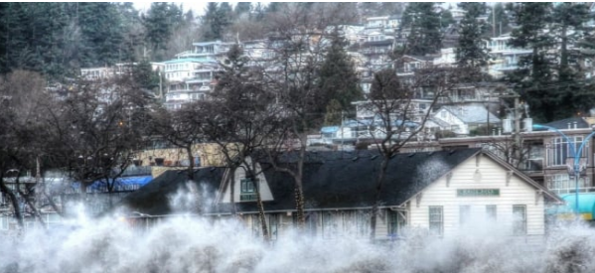
Does Canada Prepare for this Scenario?
Canada is ready to deal with the impacts of the rising sea level.
However, it is not fully prepared for sea level rise
It is racing towards finding ways of dealing with the challenges of sea-level rise
This is the major focus to avoid see rise risks in the future.
Notes:
Canada is preparing to deal with the impacts of the rising sea level.
It is racing towards finding ways of dealing with the challenges of sea-level rise
This is the major focus to avoid see rise risks in the future.

Slide 18
Continued:
To find solutions, Canada has organized conferences where both international and local experts share their insights. In such conferences, experts have drawn from research that by 2100 the sea level might rise by one meter (City of Vancouver, 02:40-0244).
Such a prediction is scaring as it means that the sea will claim large chunks of land occupied by human populations. To avoid the destruction of life and property, there is a need to create awareness among the world (City of Vancouver, 02:55-02:57).
As countries like Canada prepare for the worst, everyone needs to help prevent sea-level rise's extreme impacts.
Notes:
To find solutions, Canada has organized conferences where both international and local experts share their insights. In such conferences, experts have drawn from research that by 2100 the sea level might rise by one meter (City of Vancouver, 02:40-0244).
Such a prediction is scaring as it means that the sea will claim large chunks of land occupied by human populations. To avoid the destruction of life and property, there is a need to create awareness among the world (City of Vancouver, 02:55-02:57).
As countries like Canada prepare for the worst, everyone needs to help prevent sea-level rise's extreme impacts.

Slide 19
Continued: Does Canada Prepare For This Scenario?
To find solutions, Canada has organized conferences where both international and local experts share their insights. In such conferences, experts have drawn from research that by 2100 the sea level might rise by one meter (City of Vancouver, 02:40-0244).
Such a prediction is scaring as it means that the sea will claim large chunks of land occupied by human populations. To avoid the destruction of life and property, there is a need to create awareness among the world (City of Vancouver, 02:55-02:57).
As countries like Canada prepare for the worst, everyone needs to help prevent sea-level rise's extreme impacts.
Notes:
To find solutions, Canada has organized conferences where both international and local experts share their insights. In such conferences, experts have drawn from research that by 2100 the sea level might rise by one meter (City of Vancouver, 02:40-0244).
Such a prediction is scaring as it means that the sea will claim large chunks of land occupied by human populations. To avoid the destruction of life and property, there is a need to create awareness among the world (City of Vancouver, 02:55-02:57).
As countries like Canada prepare for the worst, everyone needs to help prevent sea-level rise's extreme impacts.

Slide 20
Conclusion.
Global warming is a threat to the human population and has contributed to ocean salinity which is creating of scarcity of freshwater for human consumption.as human being, we should take all steps and under all cost try as much as possible to make the seawater drinkable water. This is possible through desalination . Apart from that, there is a need for water sources on earth to be preserved. The earth is exposed to destruction with a rapid rise in sea level which is causing harm to human settlements near the coastal cities. However, people are also contributing to these problems and I could suggest that there is a need to practice activities that are not harmful to the environment. Besides, we need to consider the importance of Antarctica. This is a huge frozen ice sheet in our planet and it is very essential for human survival. The ice on it helps in deflecting rays of sun away from the earth. It also useful in making temperatures a bit livable. Lastly, w need to be prepared to rising sea levels. This is important because it is the only solution we could avoid any harm caused by global warming.
Notes:
Global warming is increasing owing to human activities that are destructive to the environment. The temperatures have rapidly risen, resulting from the destruction of the ozone layer. The human population cannot survive without the ozone layer and the Antarctic sea, which are important to the ecosystem. Human beings should ensure that they practice activities that will preserve water sources and the atmosphere. Global warming is a threat to the human population and has contributed to ocean salinity which is creating of scarcity of freshwater for human consumption.as human being, we should take all steps and under all cost try as much as possible to make the seawater drinkable water. This is possible through desalination . Apart from that, there is a need for water sources on earth to be preserved. The earth is exposed to destruction with a rapid rise in sea level which is causing harm to human settlements near the coastal cities. However, people are also contributing to these problems and I could suggest that there is a need to practice activities that are not harmful to the environment. Besides, we need to consider the importance of Antarctica. This is a huge frozen ice sheet in our planet and it is very essential for human survival. The ice on it helps in deflecting rays of sun away from the earth. It also useful in making temperatures a bit livable. Lastly, w need to be prepared to rising sea levels. This is important because it is the only solution we could avoid any harm caused by global warming.

Slide 21
References.
https://www.youtube.com/watch?v=uOMRF7t5Vn0
https://www.cnbc.com/2019/10/20/desalination-plants-provide-clean-drinking-water-to-the-
https://www.cnbc.com/2019/10/20/desalination-plants-provide-clean-drinking-water-to-the-

